Slide 1
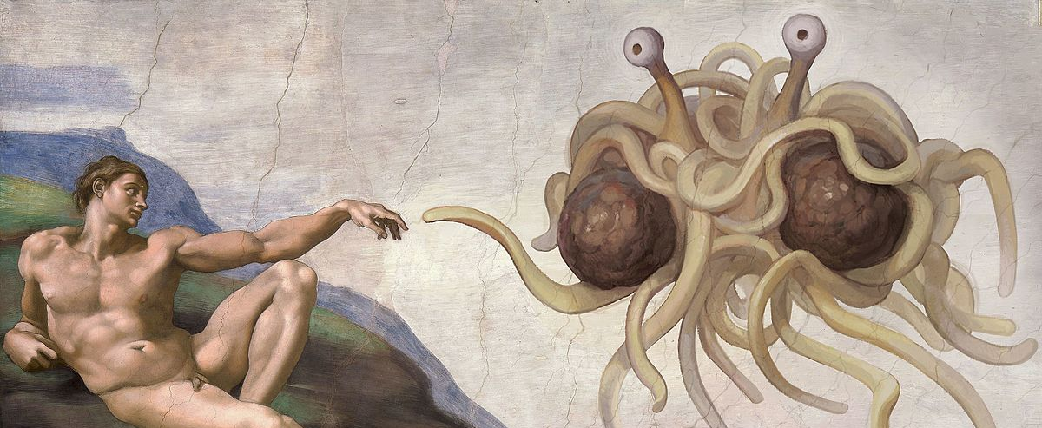
SOEE1475 Statistics and Data Analysis
Lecture 3: Bivariate statistics
Graeme T. Lloyd

Slide 2

Today
Introduction to bivariate data
Regression
Correlation

Slide 3
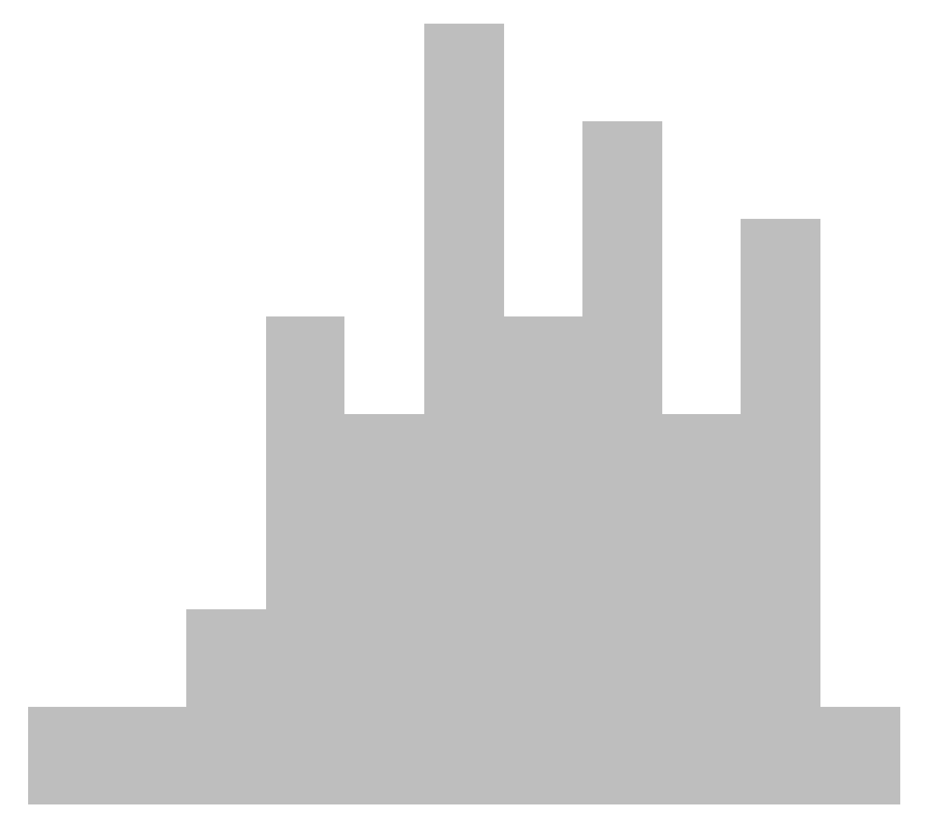
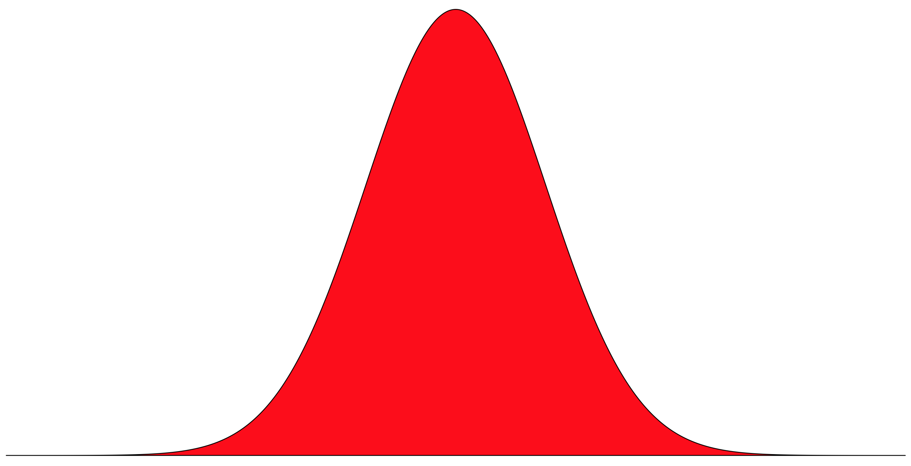
Univariate data
Population
Sample

Slide 4
Bivariate data
Dependent / Response variable
The variable we wish to explain; by convention y
Independent / Explanatory variable
The variable we believe explains y; by convention x

Slide 5
Bivariate data
Atmospheric CO₂
Global temperature

Slide 6
Linear regression
Slope
y
x

Slide 7
Linear regression
y
x

Slide 8
Linear regression
Slope
y
y = ax + b
Intercept
x

Slide 9
Linear regression
Interpolation
Extrapolation
y
y
x
x

Slide 10
Linear regression
y
x

Slide 11
Linear regression
(Least squares)
y
x

Slide 12
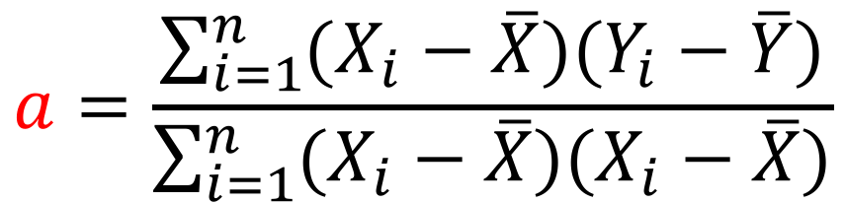
Linear regression
b = y - ax
y
$$a=\frac{\sum_{i=1}^{n}{(X_{i}−\overline{X})(Y_{i}−\overline{Y})}}{\sum_{i=1}^{n}{(X_{i}−\overline{X})(X_{i}−\overline{X})}}$$
x

Slide 13

Linear regression
slope <- lm(y ~ x)$coefficients[2]
intercept <- lm(y ~ x)$coefficients[1]

Slide 14
Linear regression
5
y
y = -1x + 6
0
0
5
x

Slide 15
Interpreting slopes
y
y
x
x
y
y
x
x

Slide 16
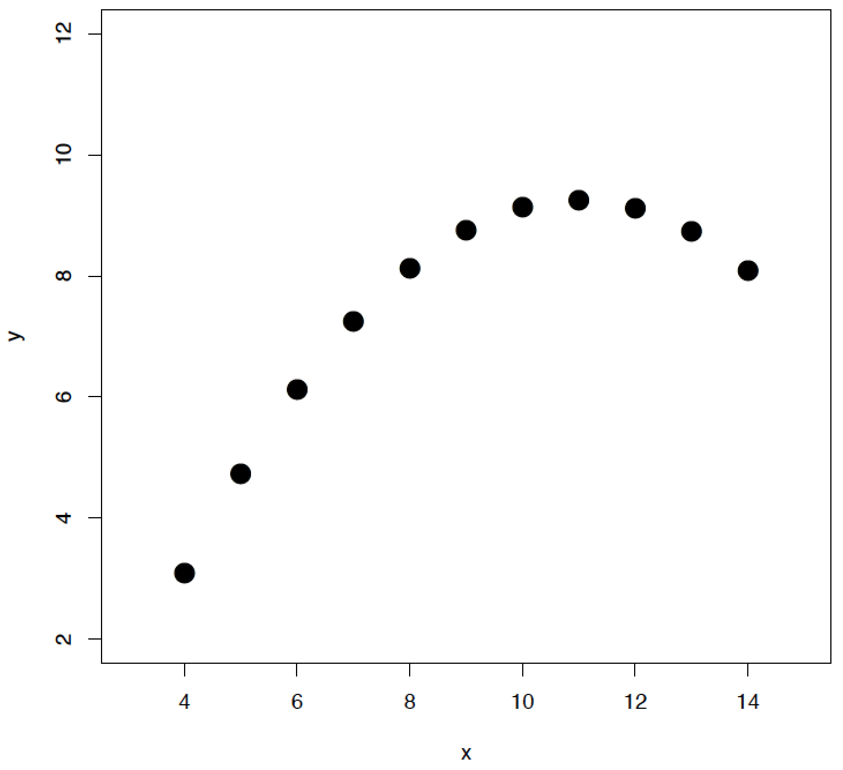
More complex regressions
lm(y ~ poly(x, 2))
lm(y ~ poly(x, 3))
lm(y ~ poly(x, 4))

Slide 17
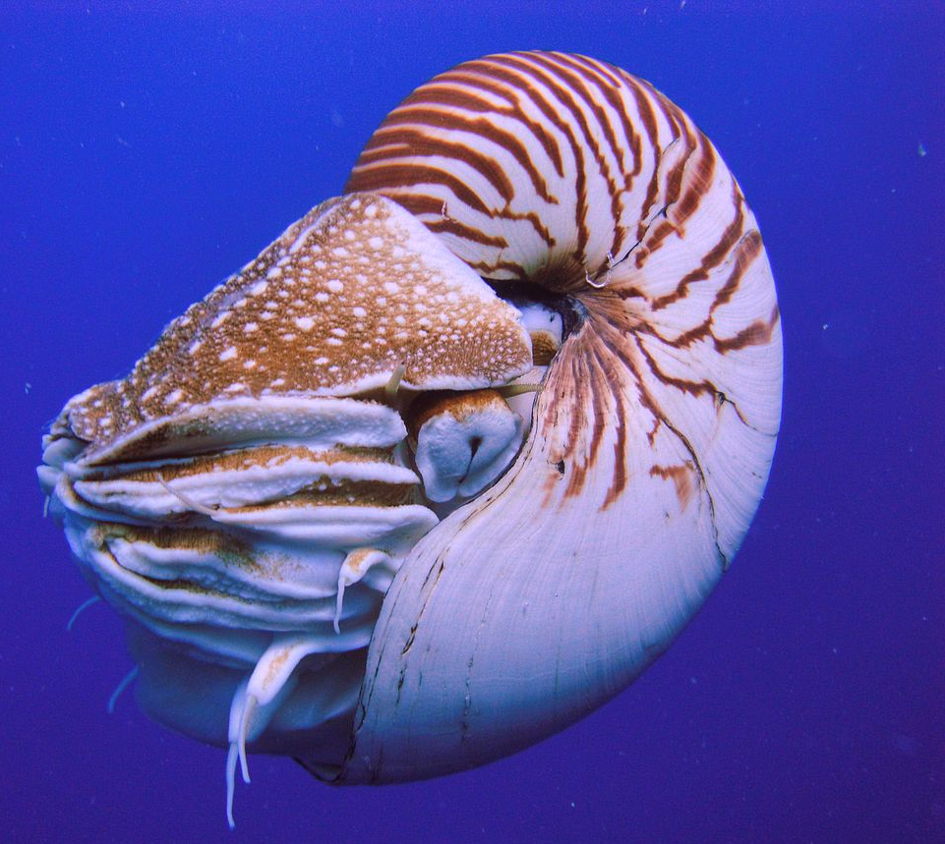
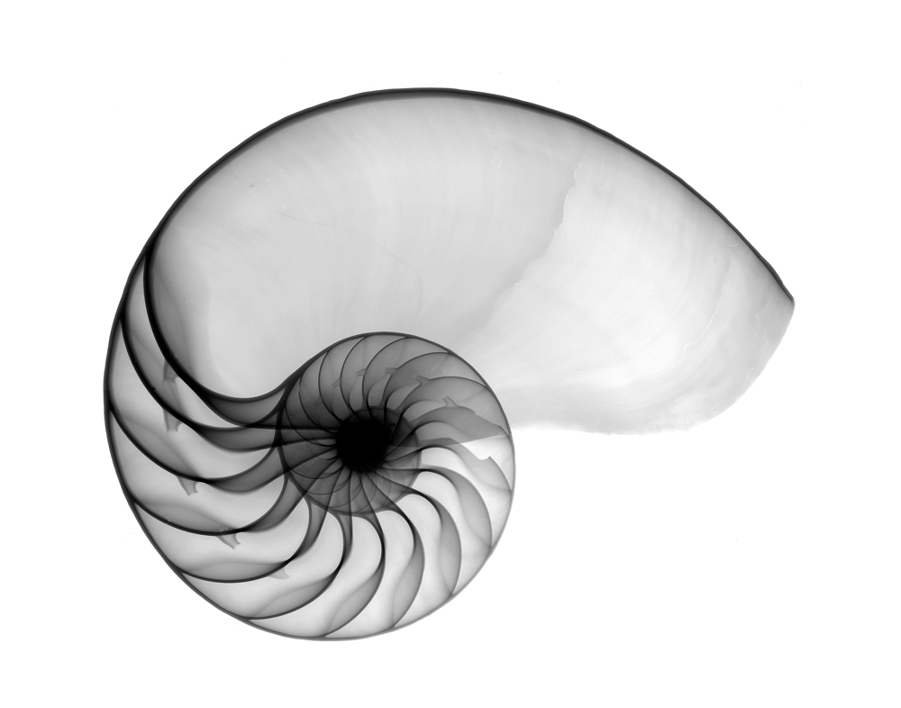
Exercise

Slide 18
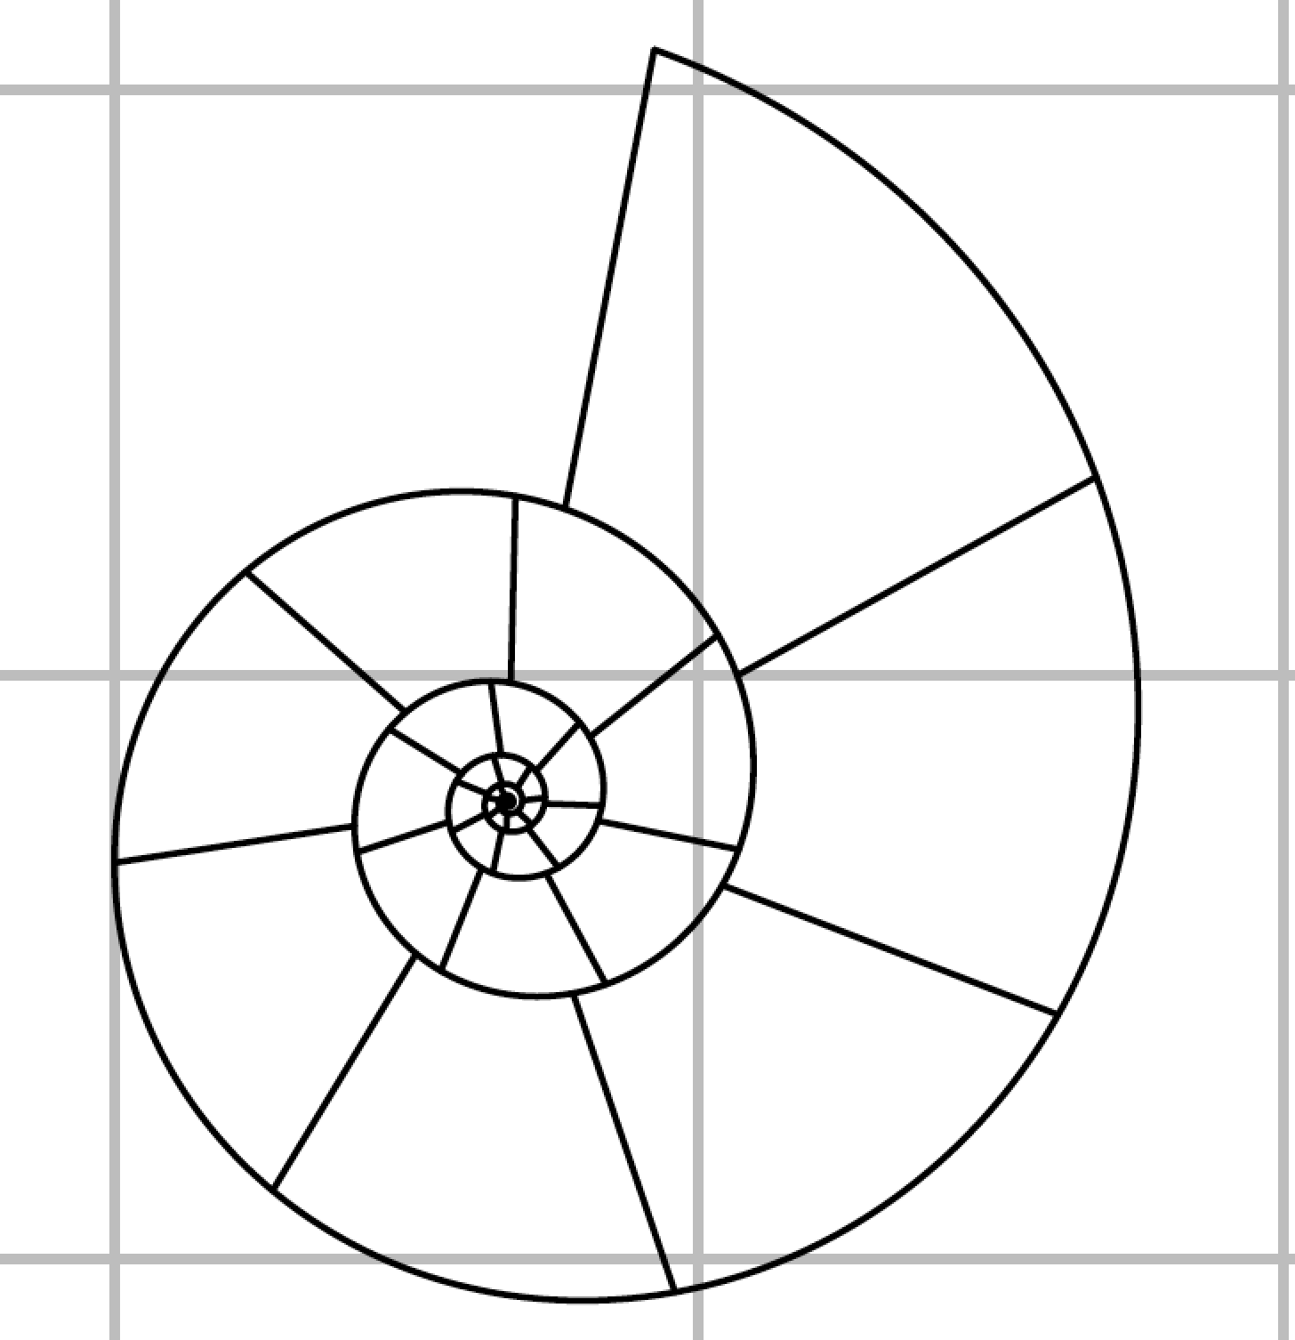
Exercise

Slide 19
Exercise
N Chambers
Diameter (mm)

Slide 20


Exercise
x <- c(20, 22, 25, 28, 30)
y <- c(70, 90, 125, 190, 280)
$$a=\frac{\sum_{i=1}^{n}{(X_{i}−\overline{X})(Y_{i}−\overline{Y})}}{\sum_{i=1}^{n}{(X_{i}−\overline{X})(X_{i}−\overline{X})}}$$
$$b=\overline{y}−a\overline{x}$$

Slide 21
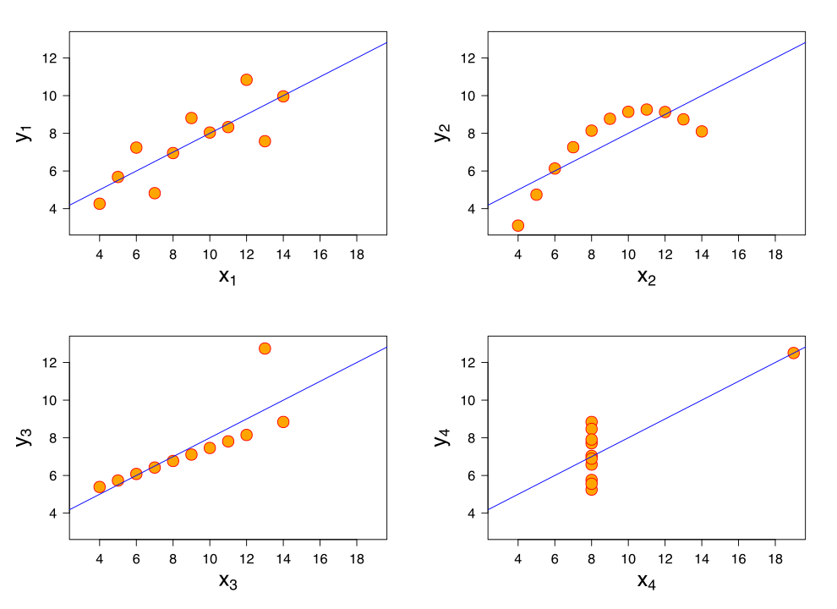
Anscombe’s quartet

Slide 22
Measuring relationships between variables
Strength of relationship
How strong of an effect does x have on y?
Sign of relationship
Does y increase (+ve) or decrease (-ve) as x increases?

Slide 23
Pearson correlation coefficient, r
-1
0
1

Slide 24
Pearson correlation coefficient, r
Step one
Normalise data (Z-statistic)
Step two
Place in expression for r that yields required values on -1 to 1 scale

Slide 25
Pearson correlation coefficient, r
Normalise
=
=

Slide 26
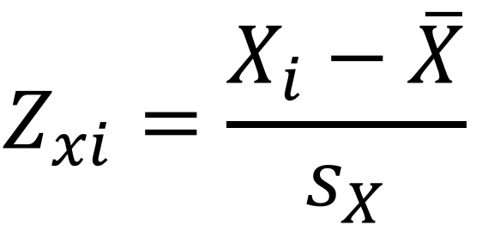
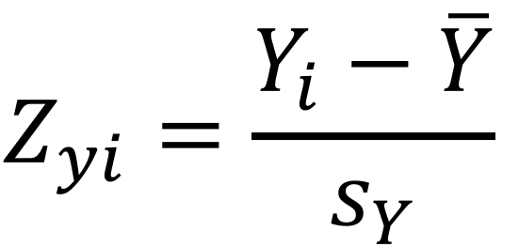
Pearson correlation coefficient, r
Normalise
Standard normal
μ
μ = 0
σ = 1
$$Z_{xi}=\frac{X_{i}−\overline{X}}{s_{X}}$$
$$Z_{yi}=\frac{Y_{i}−\overline{Y}}{s_{Y}}$$
-1σ
1σ

Slide 27
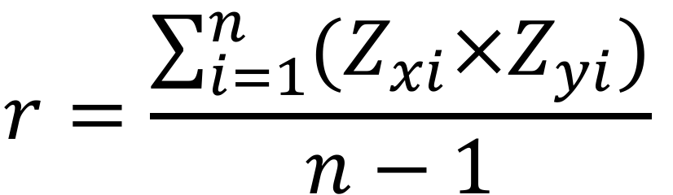
Pearson correlation coefficient, r
Expression for r
$$r=\frac{\sum_{i=1}^{n}{(Z_{xi}×Z_{yi})}}{n−1}$$

Slide 28
Pearson correlation coefficient, r
cor.test(x = x, y = y)$estimate
0.9832309
cor.test(x = x, y = y)$p.value
0.009772999

Slide 29
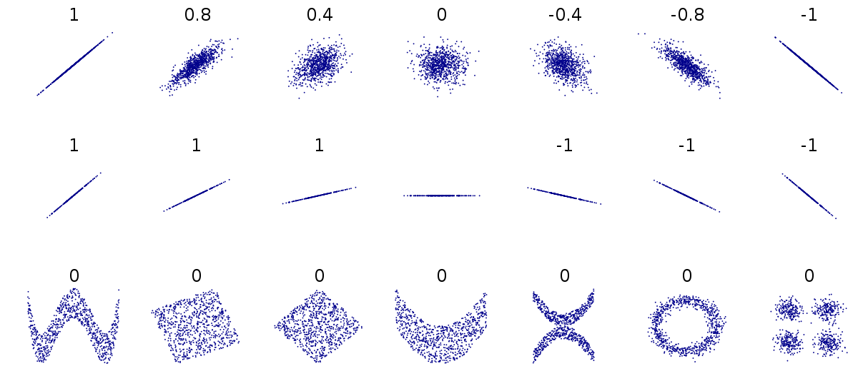
Pearson correlation coefficient, r

Slide 30
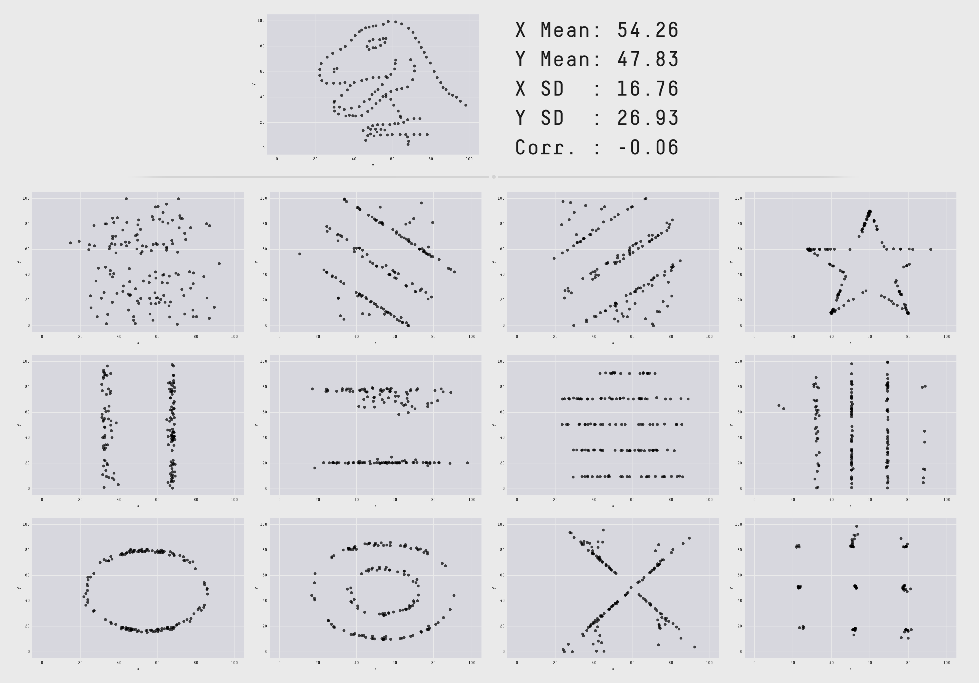
Pearson correlation coefficient, r
Source: autodeskresearch.com/
publications/samestats

Slide 31
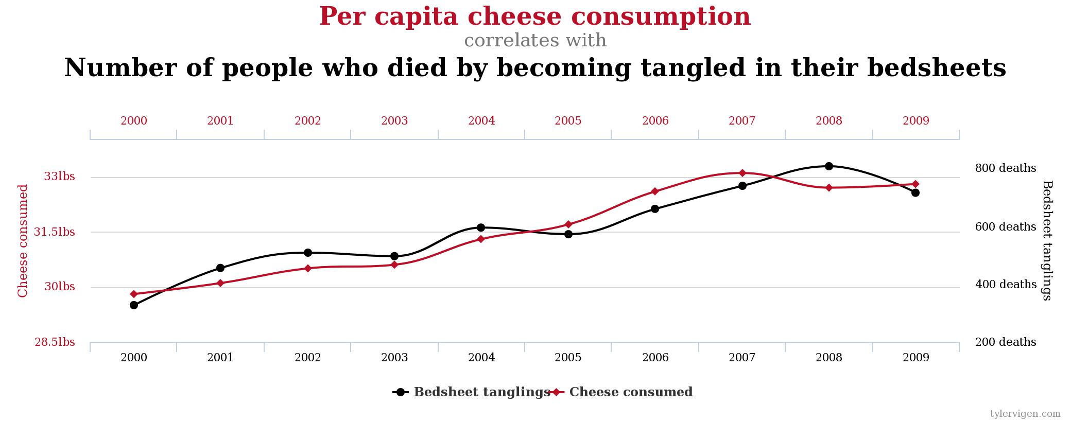
Correlation and causation
Source: tylervigen.com/spurious-correlations

Slide 32
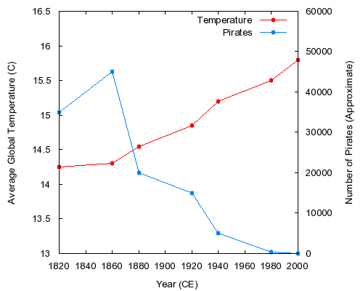

Autocorrelation
cor.test(x = pirates,
y = temp)$estimate
-0.9242241
cor.test(x = pirates,
y = temp)$p.value
0.00291353

